Slide 1

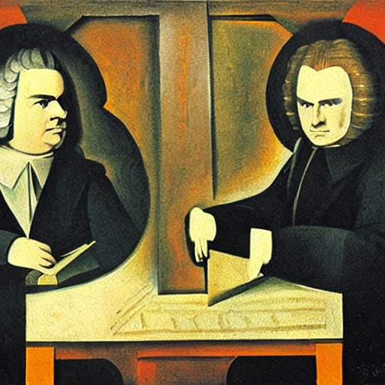
Bayes
Bach
An RNN
powered
affair
+
Brainhack Donostia 2024
github.com/qtabs/BayesPlusBach

Slide 2


Perception is actually statistical inference
latent variable
observation
Priors
Observation
Percept
Do you want to grab a …

Slide 3


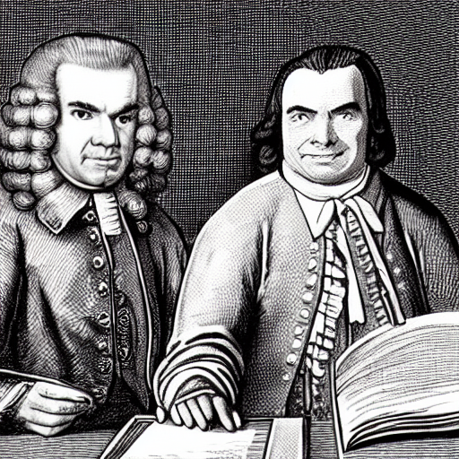

Or more eloquently,
as MY theorem says.
Shut up Bayes. You didn’t come up with that stuff and you know it.
$$p(|)=$$
$$p(|)p(|\text{recent history})$$

Slide 4

Training RNNs as a metaphor for learning
observation
latent variable
?
$$p(|\text{recent history})$$

Slide 5
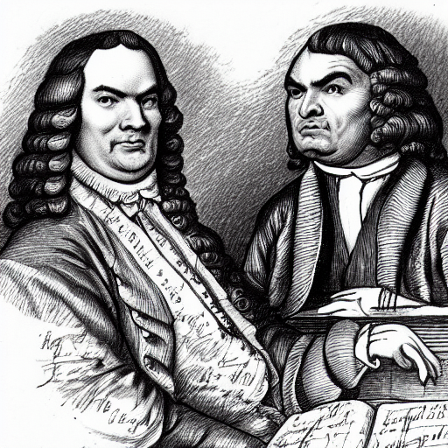


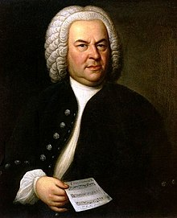
a somniferously predictable one…
my music
will do für a
fantastische
latent variable

Slide 6


Three teams to make Bayes love Bach again
Retrieval
Preprocessing
Training
latent
observation
Retrieve Bach’s music
Automatise downloads
Research new sources
Web scrapping
Parse MIDIs
Generate a dataset
Pandas + Numpy
Code architecture
Train RNNs
Pytorch

Slide 7

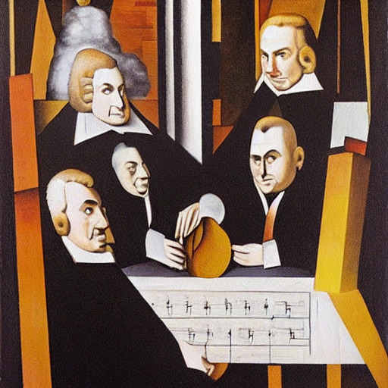



In conclusion:
Join us
Hands-on comp-neuro modelling
Sexy Machine Learning stuff
Finally getting Bayes’ theorem
Bach in the background nonstop
WHAT ELSE?!
It’ll be fun
we are
Bachbayes
trippy
DETAILED INFO: github.com/qtabs/BayesPlusBach

Slide 8


Work teams, this time for real
Retrieval
Find trustable sites with Bach’s MIDIs
Automatise MIDI downloading
Determine works used for training
Quality control of the MIDI dataset
Skills: (Beginner coding) OR music
Learn: Web scrapping, Bach, music
Preprocessing
Decide on the format of the samples
Decide latent- > observations map
Convert MIDIs to sequences of tones
Generate training/testing datasets
Skills: basic python OR stats OR music
Learn: Numpy, Pandas, stats
Training
Code RNN in python
Decide RNN architectures to test
Devise objective function
Tune training hyperparameters
Skills: python OR machine learning
Learn: PyTorch, machine learning
Benchmarking
Devise alternative heuristic models
Try to assess optimality tools
Code the visualisation of results
Skills: python OR stats OR maths
Learn: stats, numpy, visualisation
Testing
Code linear networks to readout RNN
Devise testing strategies
Define quantities used for testing
Skills: python OR stats OR ML
Learn: PyTorch, ML, stats

Slide 9


Mininimally-working deadlines
Monday
Tuesday
Wednesday
Retrieval
Webs selected
First MIDI files available
Preprocessing
Format/spaces selected
First samples available
Training
RNN architecture coded
Hyperparameter sets chosen
First random RNN available
Benchmarking
Heuristic models selected
Testing
Testing strategies selected
Retrieval
MIDI dataset completed
Preprocessing
All training samples available
Training
Training pipeline coded
Benchmarking
Benchmarking models coded
Testing
Linear architecture coded

